Slide 1
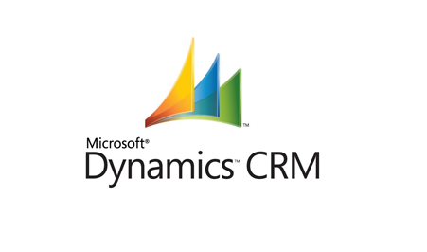
_{MS Dynamics CRM}
Presentation by
Shaik Fyjullah Ahmed

Slide 2
Contents
What's MS Dynamics CRM ?
MS Dynamics CRM Versions
CRM Products ,Market Positions
MS Dynamics CRM’s Modules
MS Dynamics CRM’s Trail Version Modules
MS Dynamics CRM’s Entities
MS Dynamics Sales Process
MS Dynamics View
Steps to Open Account/Customer record
Steps to Open Case record
MS Dynamics - Reference Architecture
Benefits of MS Dynamics CRM
Additional Documents and Links for Reference

Slide 3
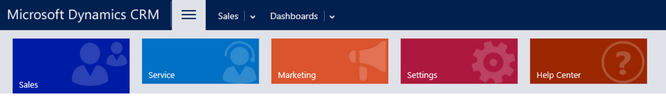
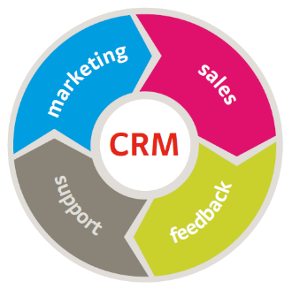
What's MS Dynamics CRM ?
MS Dynamics CRM, typically a part of a company’s customer relationship management system, is a system that records the stages in a sales, service, marketing and support process.
Customer relationship management (CRM) is an approach to managing a company’s interaction with current and future customers.
One important aspect of the CRM approach is the systems of CRM that compile information from a range of different channels, including a company’s website, telephone, email, live chat, marketing materials, social media, and more.
Through the CRM approach and the systems used to facilitate CRM, businesses learn more about their target audiences and how to best cater to their needs.
CRM systems can also give customer-facing staff detailed information on customers' personal information, purchase history, buying preferences

Slide 4
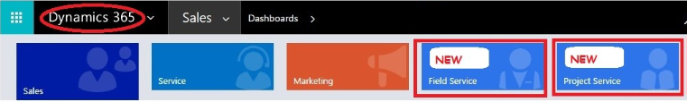
MS Dynamics CRM Versions
2003
- Microsoft CRM 1.0 & Microsoft CRM 1.2
2005
- Microsoft Dynamics 3.0
2007
- Microsoft Dynamics 4.0
2011
- Microsoft Dynamics 5.0 Or MS Dynamics CRM 2011
2013
- Microsoft Dynamics 6.0 Or MS Dynamics CRM 2013
2015
- Microsoft Dynamics 7.0 Or MS Dynamics CRM 2015
2016
- Microsoft Dynamics 8.0 , 8.1 & 8.2 Or MS Dynamics CRM 2016
2018
- Microsoft Dynamics 9.0 & 9.1 Or MS Dynamics 365

Slide 5
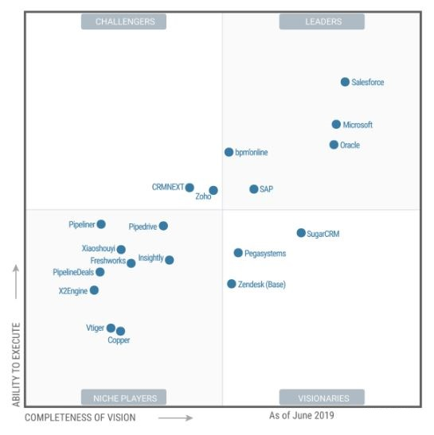
CRM Products ,Market Positions

Slide 6
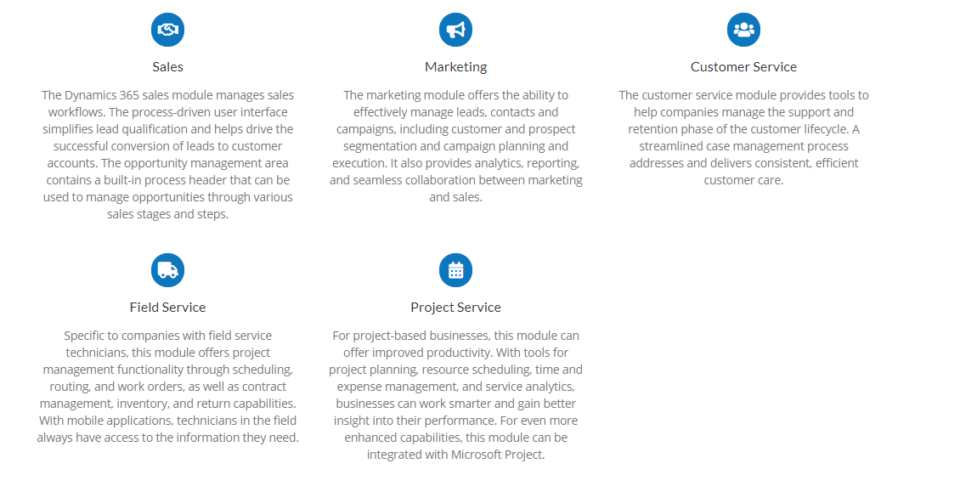
MS Dynamics CRM’s Modules

Slide 7
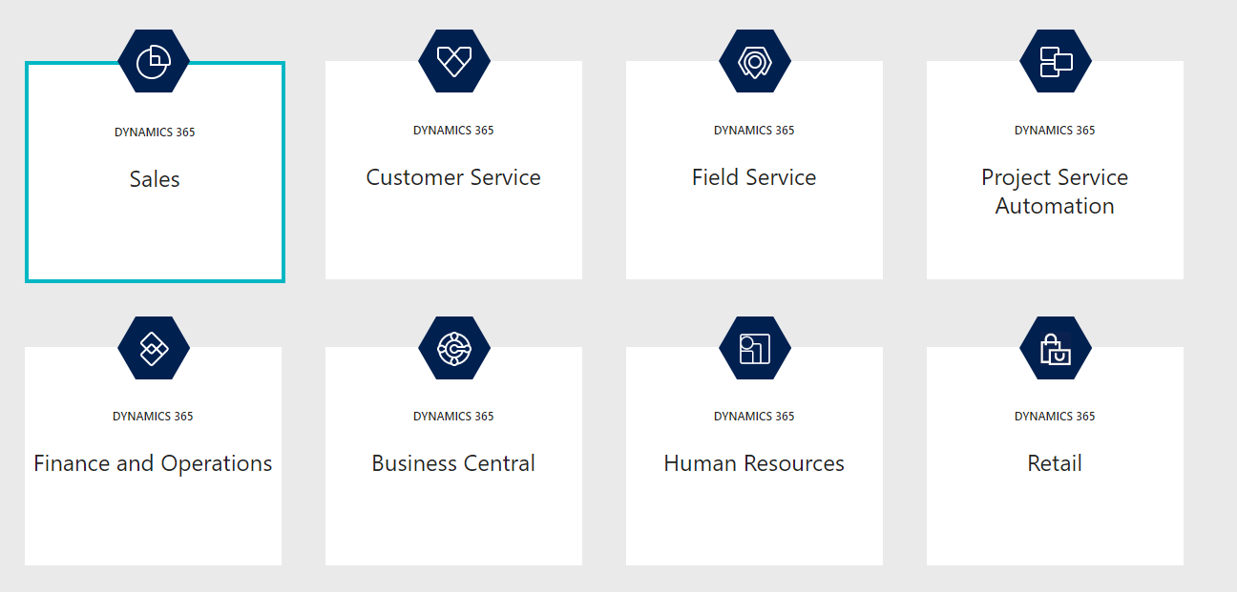
MS Dynamics CRM’s Trail Version Modules

Slide 8
MS Dynamics CRM’s Entities
Customer Management
Contact Management
Product Management
Activity Management
Case Management
Marketing Management
Campaign Management
Lead Management
Opportunity Management
Quote Management
Order Management
Pipeline Management
Target Quota managements and Reports

Slide 9
MS Dynamics CRM’s Entities
Account in CRM is about management of the customer information such as personal information, demographic information, addresses, contacts, billing etc. There are many business entities involved, modelling of business entities to form customer hierarchy is one of the important success factor.
Account Management: It facilitates the process of managing and maintaining up to date customer profile details which provides a comprehensive view of the customer.
Account management can capture historical activities, Interactions activities and full account information.
Contact is someone about whom you or your company needs to keep business or personal information. CRM helps to manage contacts and associate contact data with accounts, opportunities, trouble tickets, or service requests
Contact Management facilitates maintaining customer contacts providing access to key customer contacts including decision makers and influencers and highlighting their contact preferences such as communication medium, timings and notifications.
Customer and Contact Management: Capturing & tracking of all activities and interactions for each customer.

Slide 10
MS Dynamics CRM’s Entities
Lead Management
A lead is an unqualified business opportunity or potential relationship, all the activities records right from identifying a lead to qualification.
Opportunity and Quote Management :
A Qualified lead is an opportunity. Qualified Opportunity is required to generate
Quotes to provide product price & Discounts.
Sales Request Management
When a proposal is accepted by the customer, the authorized user will convert the
quotation into a sales request which will subsequently mark the originating opportunity as Won.

Slide 11
MS Dynamics CRM’s Entities
Activity Management :
Allows users to manage tasks, phone calls, SMS, e-mail messages, appointments, letters, and other custom activities. Activity reports are used to track performance and execution of the sales efforts.
Pipeline Management :
Allows a sales person and/or management to more accurately forecast their sales, better manages their time,and ultimately closes more sales with better understanding of the sales pipeline’s health in order to achieve targets.
Target Quota managements and Reports :
Quota and target management enables to set sales, marketing or business goals in an organization

Slide 12
MS Dynamics Sales Process
Include a sequence of sales activities
Guide sales reps through each discrete step in the sales process
Lead
Opportunity
Quote
Sale Order Request
Sales process

Slide 13
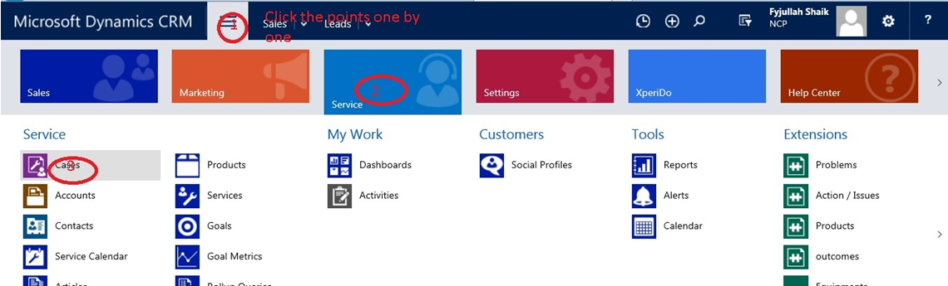
MS Dynamics View
Streamlined Navigation

Slide 14
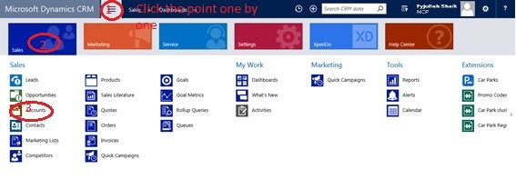
Steps to Open Account/Customer record
Step:01. Navigate to MS Dynamics CRM>>Sales>>Account/Customer.

Slide 15
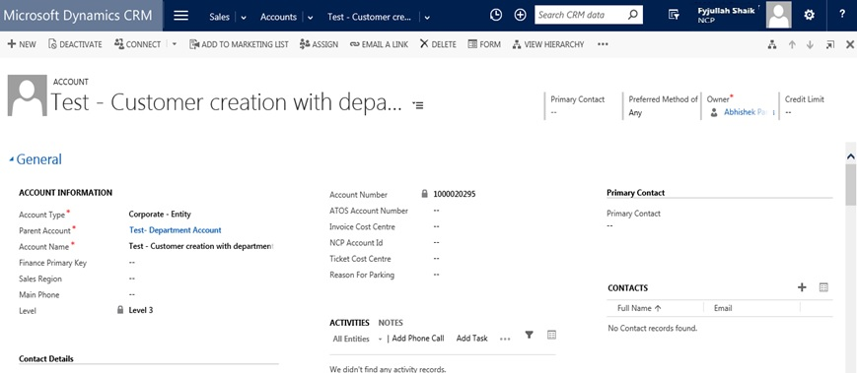
Steps to Open Account/Customer record
Step:02. Select and open Account/Customer record.

Slide 16
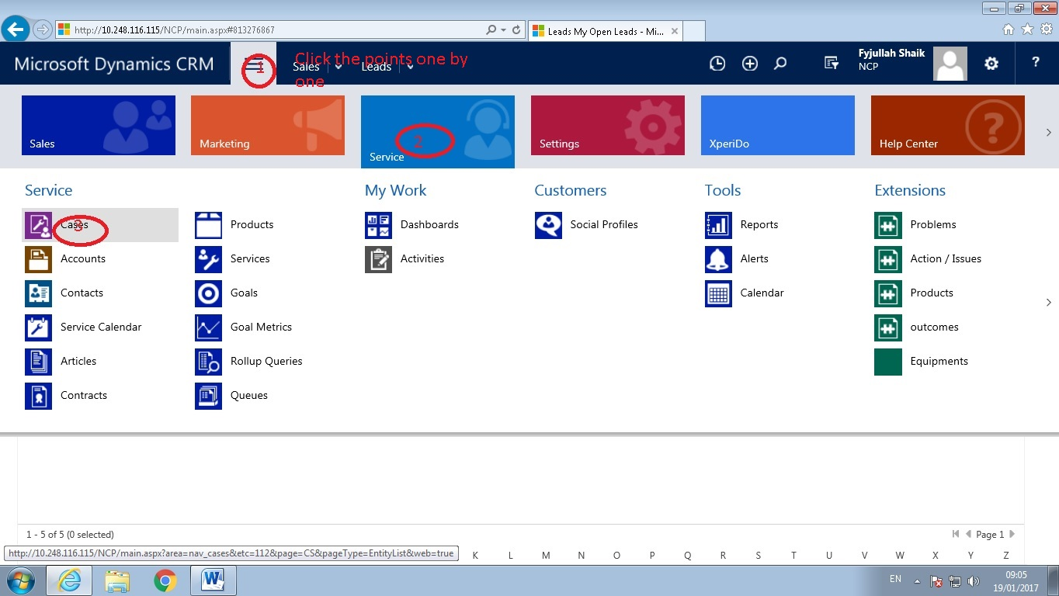
Steps to Open Case record
Step:01. Navigate to MS Dynamics CRM>>Service>>Cases.

Slide 17
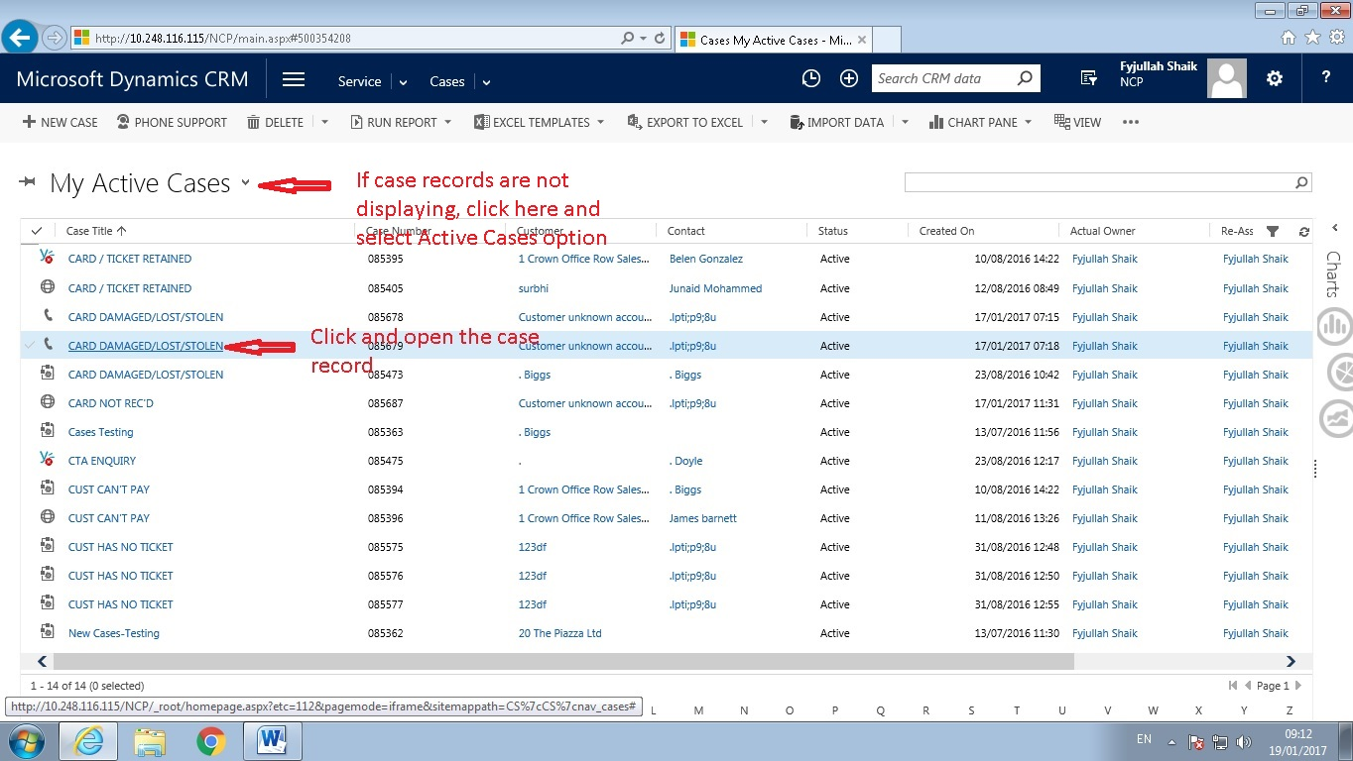
Steps to Open Case record
Step:02. Select the Case record.

Slide 18
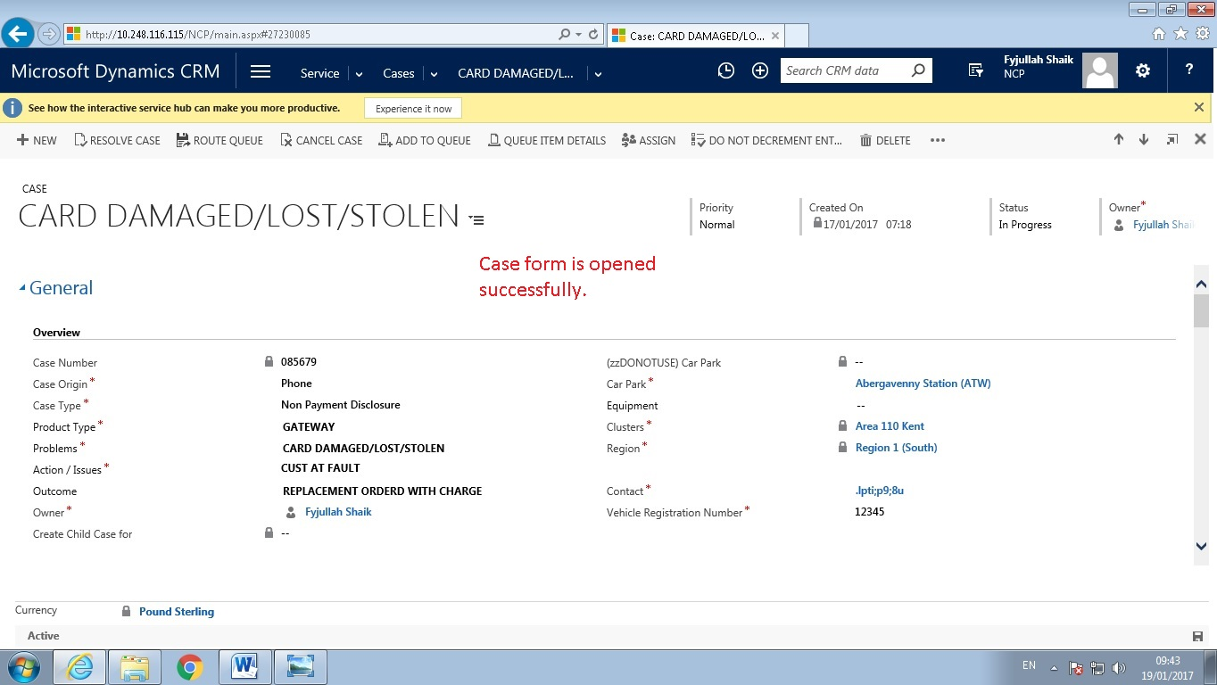
Steps to Open Case record
Step:03. Open the Case record.

Slide 19
MS Dynamics- Case form Explanation
How to create new Record?
Why do I need to pay attention to this record?
What is this record about?
What is the status
of this record?
Is this record
currently saved?
Primary or General Information

Slide 20
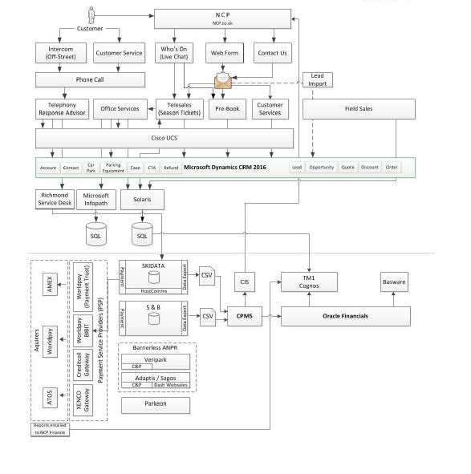
MS Dynamics - Reference Architecture

Slide 21
Benefits of MS Dynamics CRM
Microsoft Dynamics CRM integrates with the Microsoft technology stack assets, such as Microsoft SharePoint for collaboration and content management, Microsoft Lync for presence and IM, Microsoft Visual Studio for extended customization and Microsoft Outlook for
New process UI significantly improves the user experience.
Interoperability is available between Microsoft Dynamics on-premises and SaaS versions.
Streamline sales cycles.
Increases the selling time and Automate sales Process by Integrating with various departments.
Drive much higher close/ won rates.
For Example: Giving appropriate products and solutions to customer from Catalogue . Solutions from technical architect where ever required . Alerts and Control at sales stages etc.
Improve customer service.
For Ex :Managing Activity of customer , Duplicate follow up can be avoided .
Maintains Competitor details
Forecasting
Up selling and cross selling

Slide 22
Additional Documents and Links for Reference
MS Dynamics CRM user Guide document.
MS Dynamics CRM Trail Instance Link.
https://trials.dynamics.com

Slide 23

Queries?
Please email me for any Questions / Information.
Shaikfyjullah.ahmed@cognizant.com

Slide 24

Thank You.

